Slide 1
DCIT 212 NUMERICAL AND COMPUTATIONAL METHODS
Session 4 – Eigenproblems - Part II
Lecturer: Justice K. Appati, PhD., UG, DCS
Contact Information: jkappati@ug.edu.gh

Slide 2
Course Information
Provide the following information:
Course Code: | DCIT 212
Course Title: | Numerical and Computational Methods
Course Credit | 3
Session Number & Session Title: | 4 & Eigenproblems - Part II
Semester/Year: | 2 / 2021

Slide 3
Course Information (contd.)
Provide the following information:
Lecture Period(s) | 2
Prerequisites | DCIT 105: Mathematics for IT Professionals
Teaching Assistant | TBD

Slide 4
Course Instructor’s Contact
Provide the following information:
Course Instructor(s) Name | Justice K. Appati, PhD.
Office Location | Stat 010, Statistics Building
Office Hours | TBD
Phone | N/A
E-mail | jkappati@ug.edu.gh

Slide 5
Session Overview
In this session we will look at the QR method in evaluating the eigenproblem. We will also look at how the eigenvectors can be computed and their relevance to society. Other methods of equal importance in addressing eigenproblem will be discussed.

Slide 6
Session Outline
The QR Method
Eigenvectors
Other Methods

Slide 7
Learning Objectives
After completing this session, you will be able to:
Explain how the QR method works.
Estimate eigenvalues using QR method.
Evaluate eigenvectors
Describe other methods for eigenproblems.

Slide 8
Session Activities and Assignments
This week, complete the following tasks:
Log onto the UG Sakai LMS course site: http://sakai.ug.edu.gh/
Read Chapter 2 (Pages 104-111) of the Recommended Textbook – Joe D. Hoffman (2001), Numerical Methods for Engineers and Scientists (2nd Edition).
Review Lecture Slides: Session 4 – Eigenproblems - Part II
Visit the Chat Room and discuss the Forum question for Session 4
Complete the Individual Assignment for Session 4

Slide 9
Reading List
Read Chapter 2 (Pages 104-111) of the Recommended Textbook – Joe D. Hoffman (2001), Numerical Methods for Engineers and Scientists (2nd Edition).

Slide 10
The QR MEthod
Topic One

Slide 11
The QR Method
The power method and the direct method treated so far only finds individual eigenvalues.
The QR method on the other hand finds all of the eigenvalues of the matrix simultaneously.
The implementation of the QR method, without proof is presented in subsequent slides

Slide 12
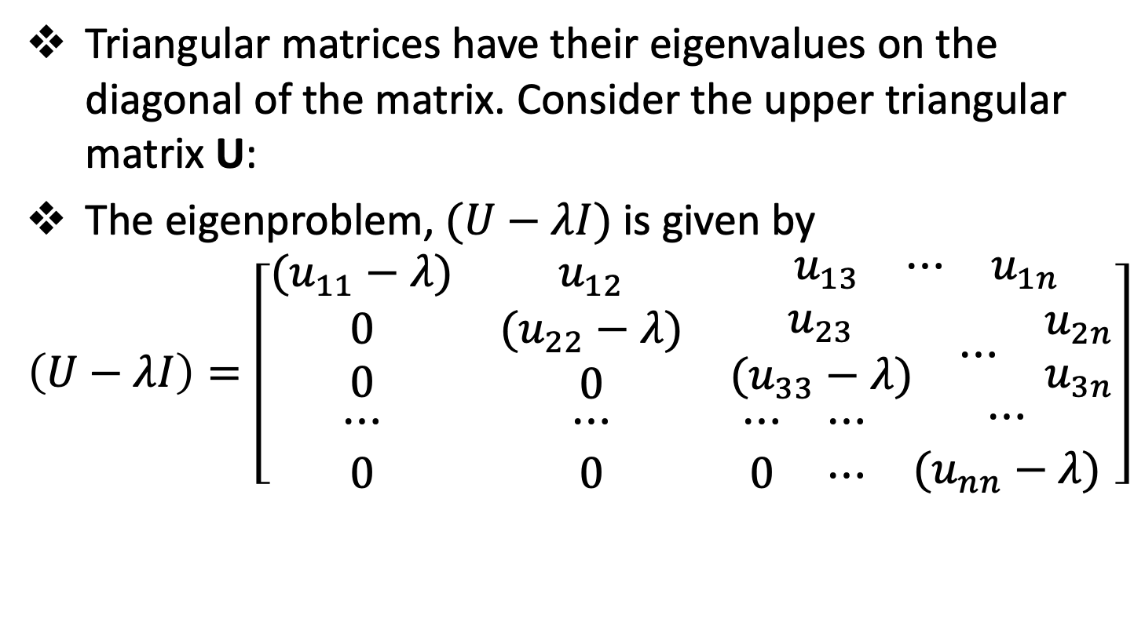
The QR Method
Triangular matrices have their eigenvalues on the diagonal of the matrix. Consider the upper triangular matrix U:
The eigenproblem, $(U−λI)$ is given by
$$\left(U−λI\right)=\left[\begin{matrix}(u_{11}−λ) & u_{12} & \begin{matrix}{ u}_{13} & ⋯ & u_{1n}\end{matrix} \\ \begin{matrix}0 \\ 0\end{matrix} & \begin{matrix}(u_{22}−λ) \\ 0\end{matrix} & \begin{matrix}\begin{matrix}u_{23} \\ (u_{33}−λ)\end{matrix} & ⋯ & \begin{matrix}u_{2n} \\ u_{3n}\end{matrix}\end{matrix} \\ \begin{matrix}⋯ \\ 0\end{matrix} & \begin{matrix}⋯ \\ 0\end{matrix} & \begin{matrix}\begin{matrix}⋯ \\ 0\end{matrix} & \begin{matrix}⋯ \\ ⋯\end{matrix} & \begin{matrix}⋯ \\ (u_{nn}−λ)\end{matrix}\end{matrix}\end{matrix}\right]$$

Slide 13
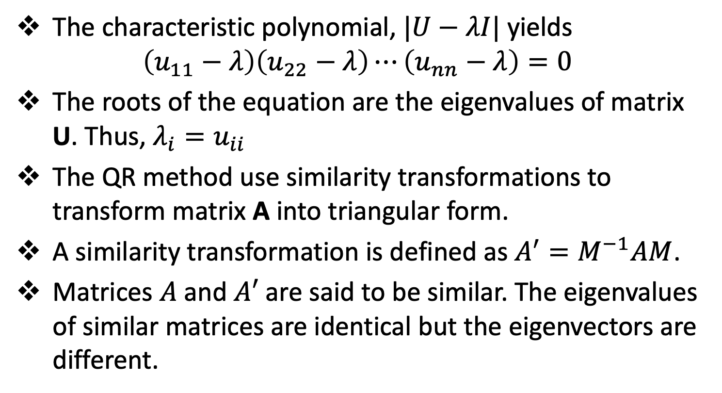
The QR Method
The characteristic polynomial, $|U−λI|$ yields
$$\left(u_{11}−λ\right)\left(u_{22}−λ\right)⋯\left(u_{nn}−λ\right)=0$$
The roots of the equation are the eigenvalues of matrix U. Thus, $λ_{i}=u_{ii}$
The QR method use similarity transformations to transform matrix A into triangular form.
A similarity transformation is defined as $A^{′}=M^{−1}AM$.
Matrices $A$ and $A′$ are said to be similar. The eigenvalues of similar matrices are identical but the eigenvectors are different.

Slide 14
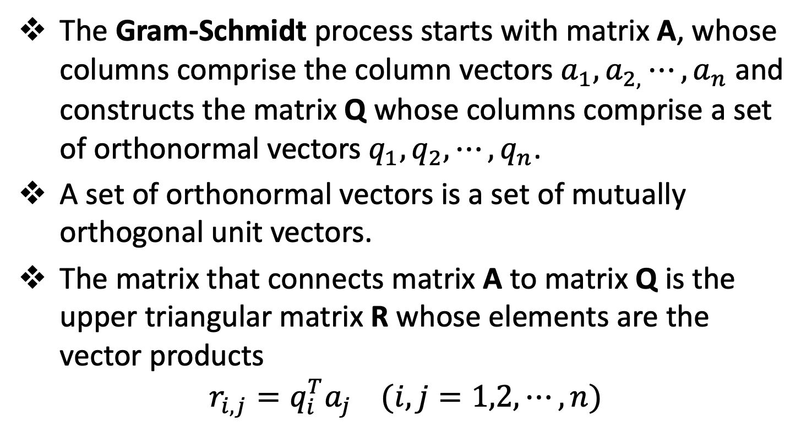
The QR Method
The Gram-Schmidt process starts with matrix A, whose columns comprise the column vectors $a_{1},a_{2,}⋯,a_{n}$ and constructs the matrix Q whose columns comprise a set of orthonormal vectors $q_{1},q_{2},⋯,q_{n}$.
A set of orthonormal vectors is a set of mutually orthogonal unit vectors.
The matrix that connects matrix A to matrix Q is the upper triangular matrix R whose elements are the vector products
$$r_{i,j}=q_{i}^{T}a_{j} (i,j=1,2,⋯,n)$$

Slide 15
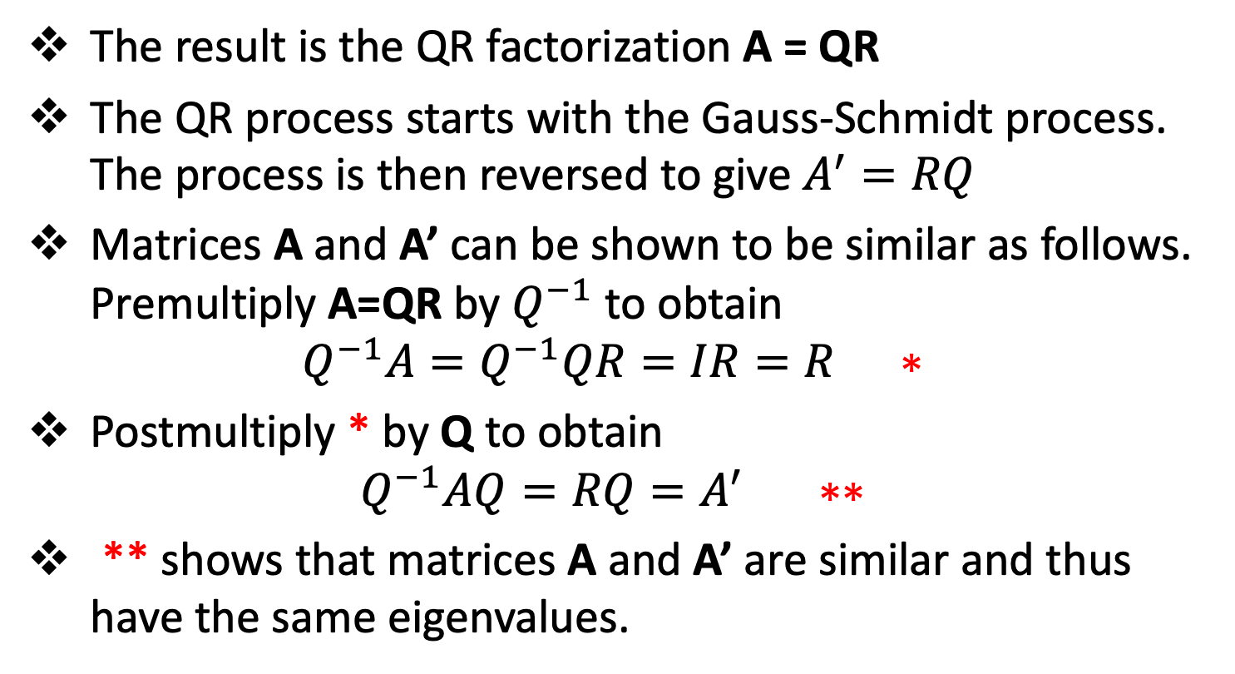
The QR Method
The result is the QR factorization A = QR
The QR process starts with the Gauss-Schmidt process. The process is then reversed to give $A^{′}=RQ$
Matrices A and A’ can be shown to be similar as follows. Premultiply A=QR by $Q^{−1}$ to obtain
$$Q^{−1}A=Q^{−1}QR=IR=R ∗$$
Postmultiply * by Q to obtain
$$Q^{−1}AQ=RQ=A^{′} ∗∗$$
** shows that matrices A and A’ are similar and thus have the same eigenvalues.

Slide 16
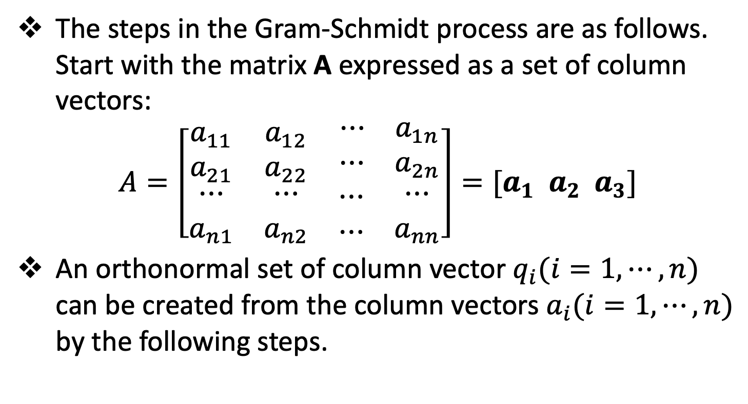
The QR Method
The steps in the Gram-Schmidt process are as follows. Start with the matrix A expressed as a set of column vectors:
$$A=\left[\begin{matrix}a_{11} & a_{12} & \begin{matrix}⋯ & a_{1n}\end{matrix} \\ a_{21} & a_{22} & \begin{matrix}⋯ & a_{2n}\end{matrix} \\ \begin{matrix}⋯ \\ a_{n1}\end{matrix} & \begin{matrix}⋯ \\ a_{n2}\end{matrix} & \begin{matrix}\begin{matrix}⋯ \\ ⋯\end{matrix} & \begin{matrix}⋯ \\ a_{nn}\end{matrix}\end{matrix}\end{matrix}\right]=[a_{1} a_{2} a_{3}]$$
An orthonormal set of column vector $q_{i}(i=1,⋯,n)$ can be created from the column vectors $a_{i}(i=1,⋯,n)$ by the following steps.

Slide 17
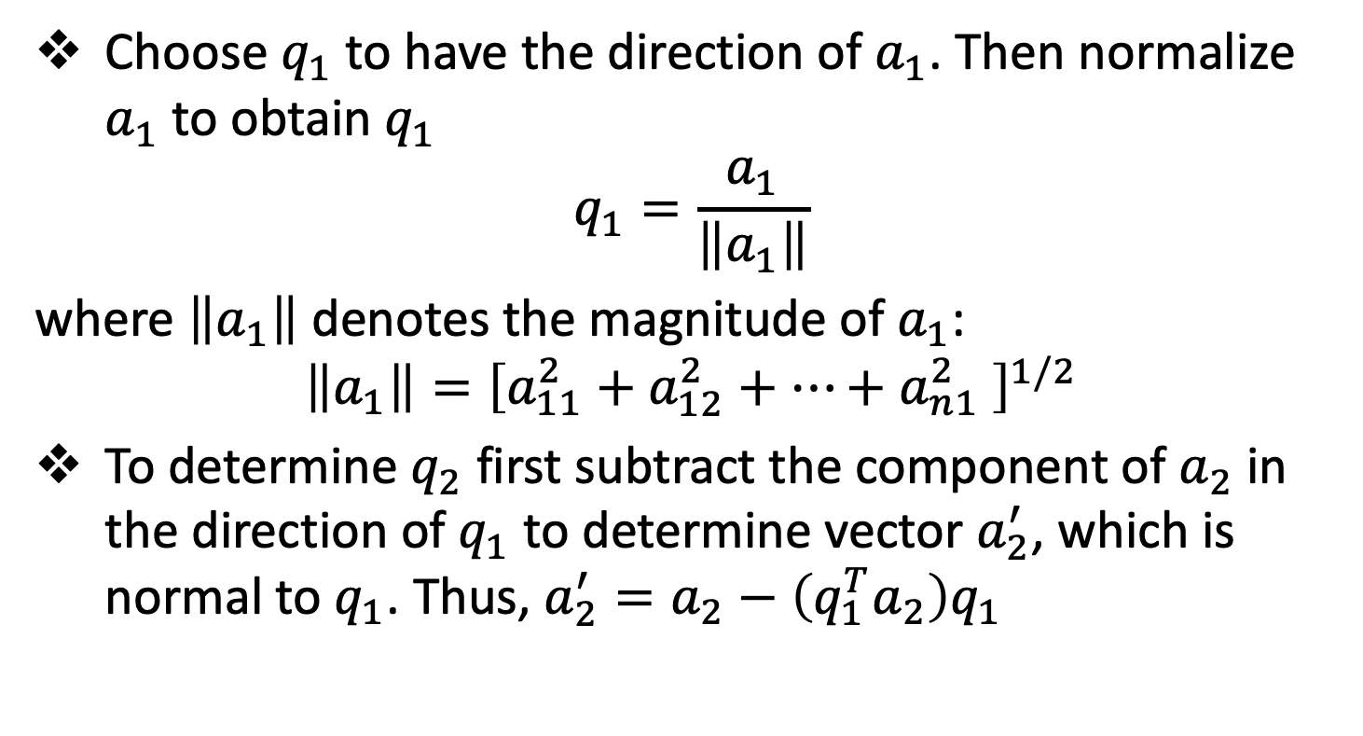
The QR Method
Choose $q_{1}$ to have the direction of $a_{1}$. Then normalize $a_{1}$ to obtain $q_{1}$
$$q_{1}=\frac{a_{1}}{\left\|a_{1}\right\|}$$
where $\left\|a_{1}\right\|$ denotes the magnitude of $a_{1}$:
$$\left\|a_{1}\right\|={\left[a_{11}^{2}+a_{12}^{2}+⋯+a_{n1}^{2} \right]}^{1/2}$$
To determine $q_{2}$ first subtract the component of $a_{2}$ in the direction of $q_{1}$ to determine vector $a_{2}^{′}$, which is normal to $q_{1}$. Thus, $a_{2}^{′}=a_{2}−\left(q_{1}^{T}a_{2}\right)q_{1}$

Slide 18
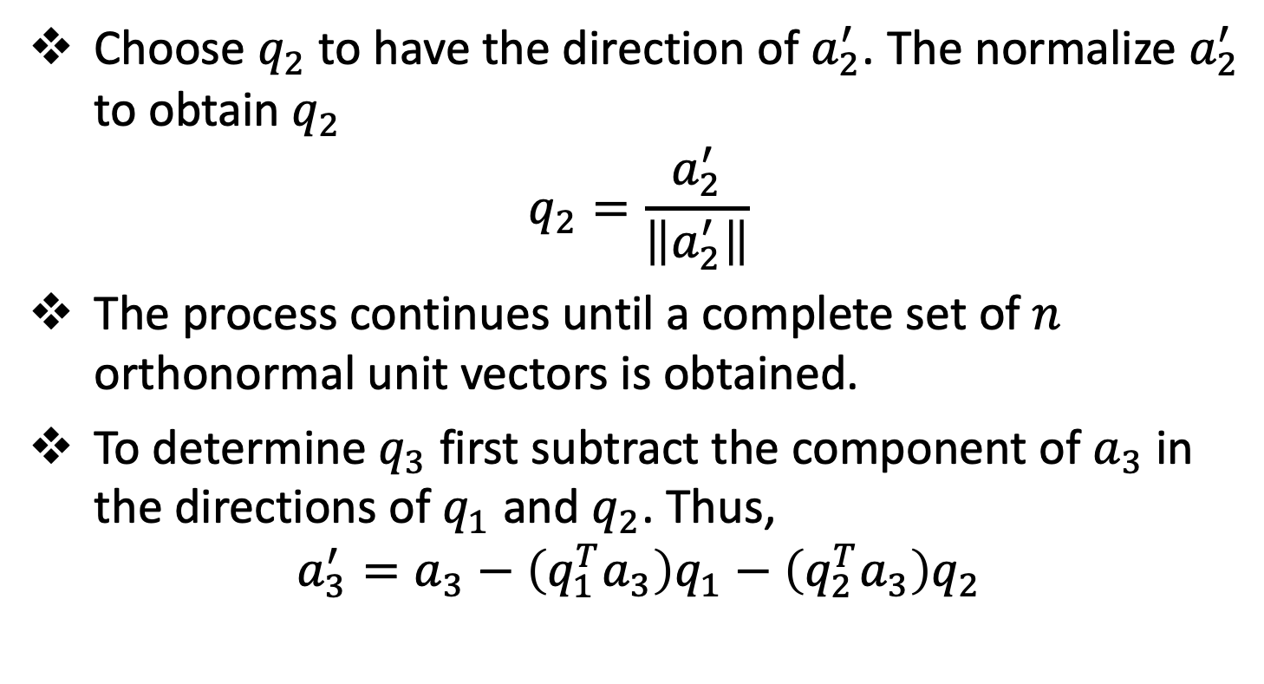
The QR Method
Choose $q_{2}$ to have the direction of $a_{2}^{′}$. The normalize $a_{2}^{′}$ to obtain $q_{2}$
$$q_{2}=\frac{a_{2}^{′}}{\left\|a_{2}^{′}\right\|}$$
The process continues until a complete set of $n$ orthonormal unit vectors is obtained.
To determine $q_{3}$ first subtract the component of $a_{3}$ in the directions of $q_{1}$ and $q_{2}$. Thus,
$$a_{3}^{′}=a_{3}−\left(q_{1}^{T}a_{3}\right)q_{1}−\left(q_{2}^{T}a_{3}\right)q_{2}$$

Slide 19
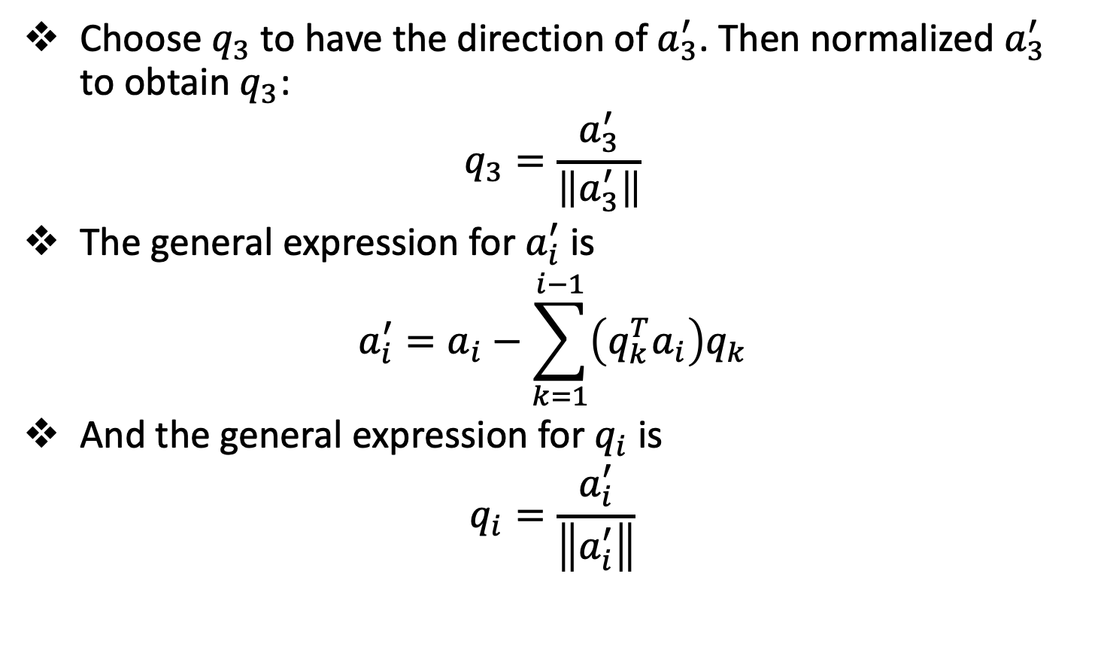
The QR Method
Choose $q_{3}$ to have the direction of $a_{3}^{′}$. Then normalized $a_{3}^{′}$ to obtain $q_{3}$:
$$q_{3}=\frac{a_{3}^{′}}{\left\|a_{3}^{′}\right\|}$$
The general expression for $a_{i}^{′}$ is
$$a_{i}^{′}=a_{i}−\sum_{k=1}^{i−1}{\left(q_{k}^{T}a_{i}\right)q_{k}}$$
And the general expression for $q_{i}$ is
$$q_{i}=\frac{a_{i}^{′}}{\left\|a_{i}^{′}\right\|}$$

Slide 20
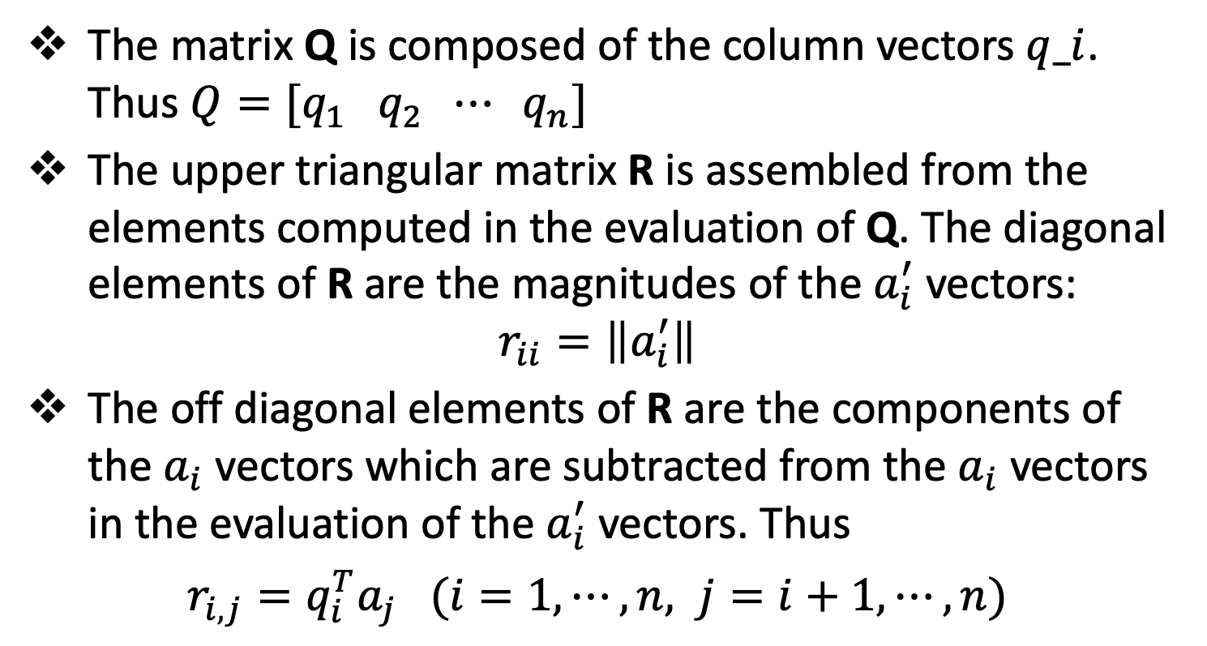
The QR Method
The matrix Q is composed of the column vectors $q_i$. Thus $Q=[q_{1} q_{2} ⋯ q_{n}]$
The upper triangular matrix R is assembled from the elements computed in the evaluation of Q. The diagonal elements of R are the magnitudes of the $a_{i}^{′}$ vectors:
$$r_{ii}=\left\|a_{i}^{′}\right\|$$
The off diagonal elements of R are the components of the $a_{i}$ vectors which are subtracted from the $a_{i}$ vectors in the evaluation of the $a_{i}^{′}$ vectors. Thus
$r_{i,j}=q_{i}^{T}a_{j} (i=1,⋯,n, j=i+1,⋯,n)$

Slide 21
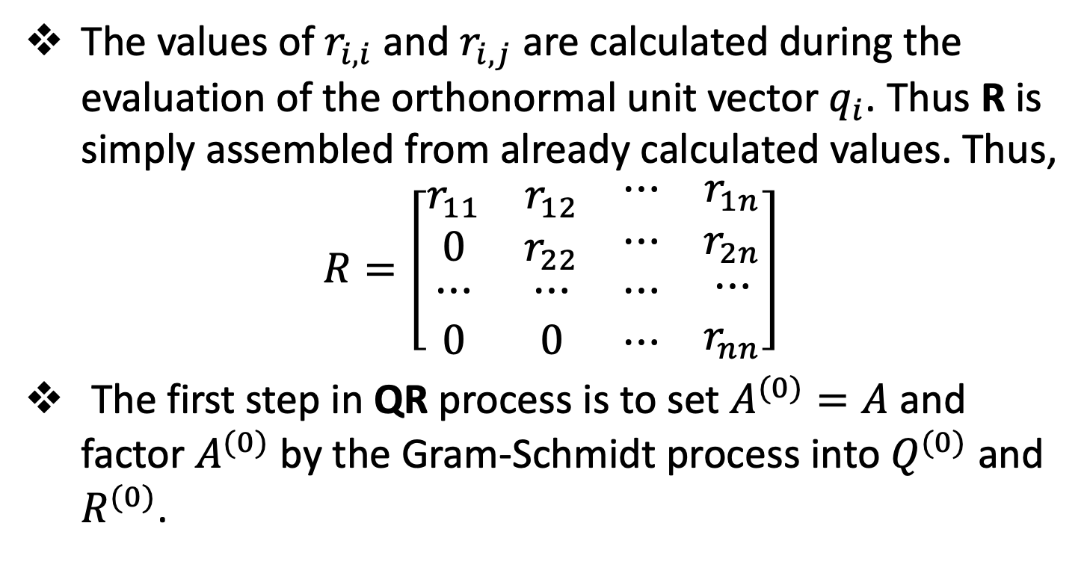
The QR Method
The values of $r_{i,i}$ and $r_{i,j}$ are calculated during the evaluation of the orthonormal unit vector $q_{i}$. Thus R is simply assembled from already calculated values. Thus,
$$R=\left[\begin{matrix}r_{11} & r_{12} & \begin{matrix}⋯ & r_{1n}\end{matrix} \\ 0 & r_{22} & \begin{matrix}⋯ & r_{2n}\end{matrix} \\ \begin{matrix}⋯ \\ 0\end{matrix} & \begin{matrix}⋯ \\ 0\end{matrix} & \begin{matrix}\begin{matrix}⋯ \\ ⋯\end{matrix} & \begin{matrix}⋯ \\ r_{nn}\end{matrix}\end{matrix}\end{matrix}\right]$$
The first step in QR process is to set $A^{(0)}=A$ and factor $A^{(0)}$ by the Gram-Schmidt process into $Q^{(0)}$ and $R^{(0)}$.

Slide 22
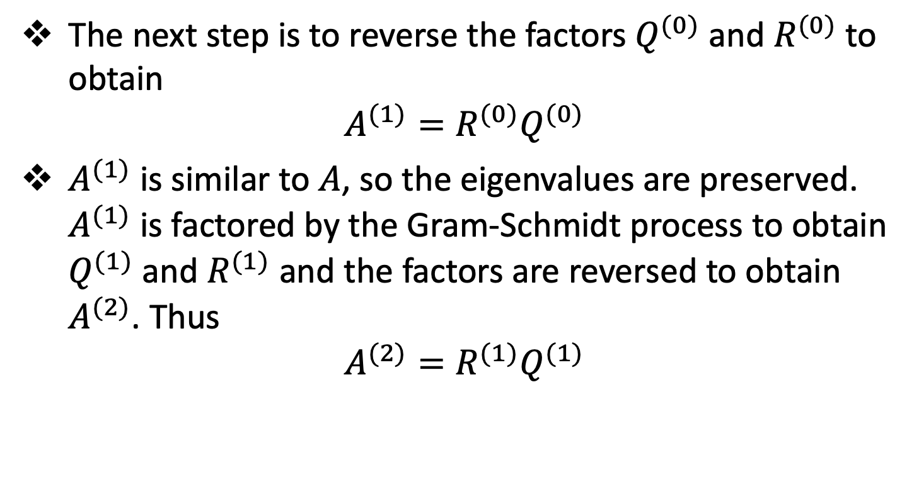
The QR Method
The next step is to reverse the factors $Q^{(0)}$ and $R^{(0)}$ to obtain
$$A^{(1)}=R^{(0)}Q^{(0)}$$
$A^{(1)}$ is similar to $A$, so the eigenvalues are preserved. $A^{(1)}$ is factored by the Gram-Schmidt process to obtain $Q^{(1)}$ and $R^{(1)}$ and the factors are reversed to obtain $A^{(2)}$. Thus
$$A^{(2)}=R^{(1)}Q^{(1)}$$

Slide 23
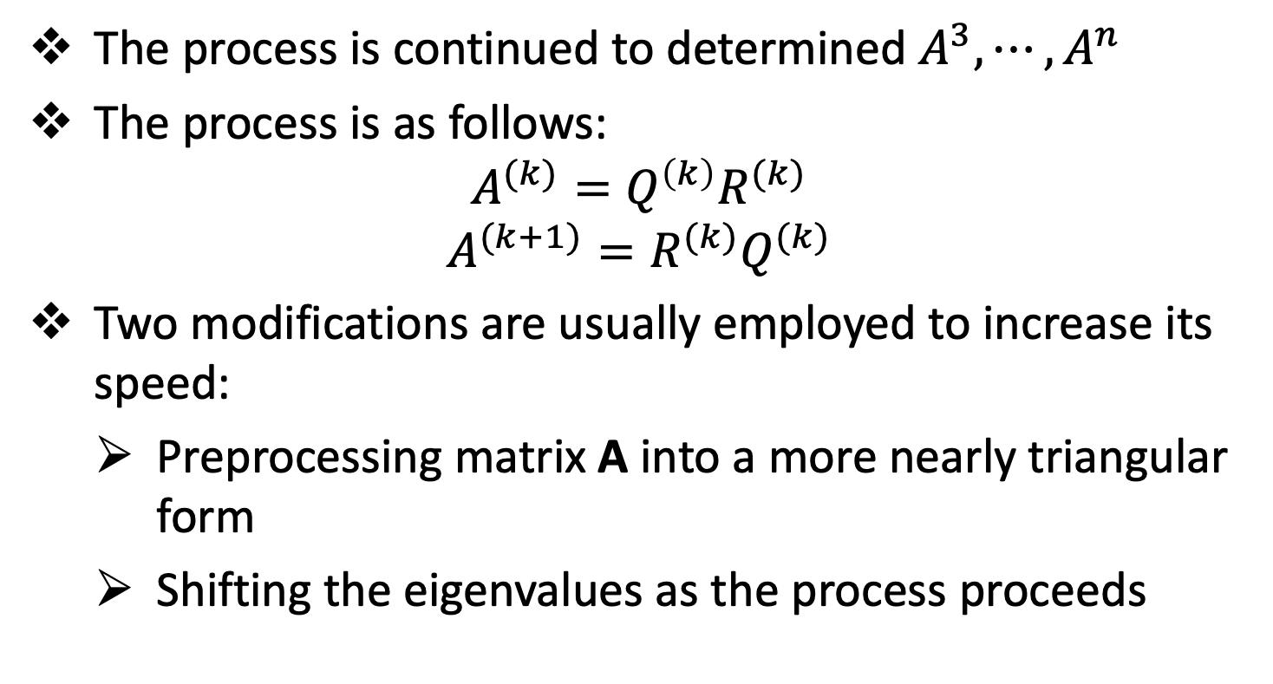
The QR Method
The process is continued to determined $A^{3},⋯,A^{n}$
The process is as follows:
$$A^{(k)}=Q^{\left(k\right)}R^{(k)}$$
$$A^{(k+1)}=R^{(k)}Q^{(k)}$$
Two modifications are usually employed to increase its speed:
Preprocessing matrix A into a more nearly triangular form
Shifting the eigenvalues as the process proceeds

Slide 24
Eigenvectors
Topic Two

Slide 25
Eigenvectors
Some methods for solving eigenproblems such as the power method, yield both the eigenvalues and the corresponding eigenvectors.
Other methods such as the direct method and the QR method, yield only the eigenvalues.
In such cases, the corresponding eigenvectors can be evaluated by shifting the matrix by the eigenvalues and applying the inverse power method on time.

Slide 26
Other Methods
Topic Three

Slide 27
Other Methods
The power method, including its variations and the direct method are very inefficient when all the eigenvalues of a large matrix are desired.
Several other methods are available in such cases. Most of these methods are based on a two-step procedure.
In the first step, the original matrix is transformed to a simpler form that has the same eigenvalues as the original matrix.
In the second step, iterative procedures are used to determine these eigenvalues.

Slide 28
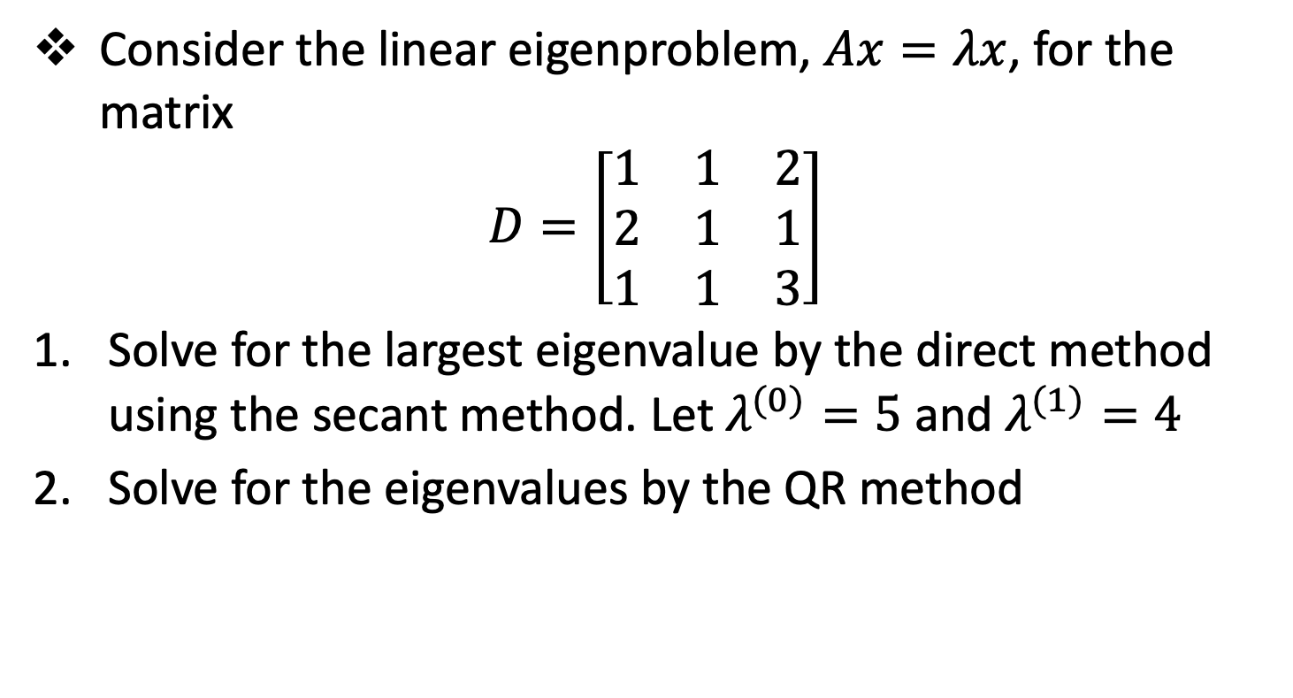
Session 4 - Assignment
Consider the linear eigenproblem, $Ax=λx$, for the matrix
$$D=\left[\begin{matrix}1 & 1 & 2 \\ 2 & 1 & 1 \\ 1 & 1 & 3\end{matrix}\right]$$
Solve for the largest eigenvalue by the direct method using the secant method. Let $λ^{(0)}=5$ and $λ^{(1)}=4$
Solve for the eigenvalues by the QR method

Slide 29
Reference
Hoffman, J. D. (2001), Numerical Methods for Engineers and Scientists (2nd Edition)
Johnston, R. L. (1982), Numerical Methods, A Software Approach, John Wiley & Sons
Kahaner, D., Moler, C., and Nash S. (1989), Numerical Methods and Software, Prentice Hall.

Slide 30
The End

